Slide 1
SOLAR TRACKER

Slide 2
01
What is Solar Tracker?
CONTENTS
02
Motivation
03
Types
04
Working
05
Conclusion

Slide 3
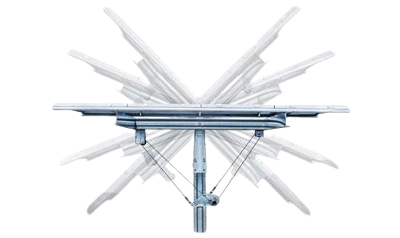
What is solar tracker
A solar tracker is a device that orients solar panels to follow the path of the sun as it moves across the sky. The primary purpose of a solar tracker is to maximize the amount of sunlight that solar panels receive throughout the day, thereby increasing their efficiency in converting sunlight into electricity.

Slide 4
Motivation
Increased Energy Production
Improved Efficiency
Better Performance in Low Light Conditions
Maximized Land Use
Seasonal and Diurnal Variations
Cost Reduction in Energy Production
These motivations collectively contribute to the adoption of solar trackers, especially in utility-scale solar power plants and installations aiming to maximize energy production and efficiency.

Slide 5
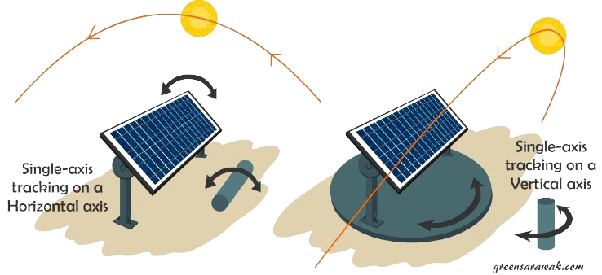
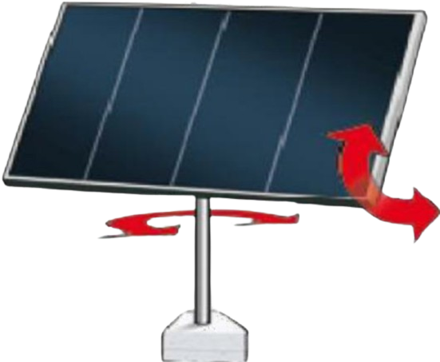
Types of solar tracker
Single Axis Solar Tracker
Horizontal Axis Tracker
Vertical Axis Tracker
Dual Axis Solar Tracker
Azimuth-Altitude Tracker
LDR tracker

Slide 6
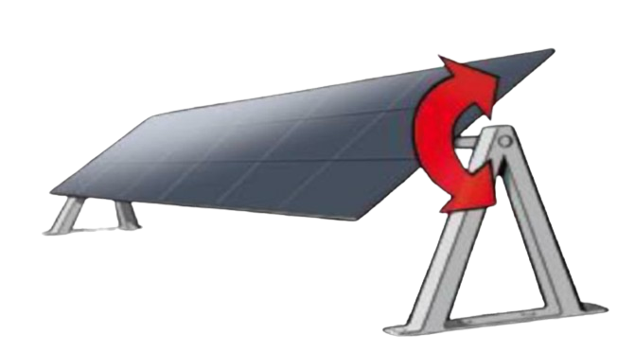
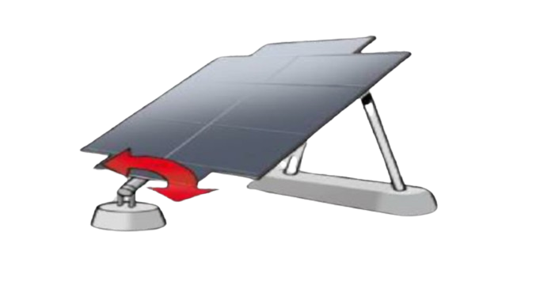
Single Axis Solar Tracker
Single-axis solar panels are designed to move along a single axis to track the sun’s movement across the sky. They adjust the orientation of solar panels horizontally or vertically.
Horizontal Axis Trackers: These trackers move the solar panels along a single horizontal axis, typically from east to west.
Vertical Axis Trackers: These trackers rotate the solar panels along a vertical axis, usually from north to south.

Slide 7
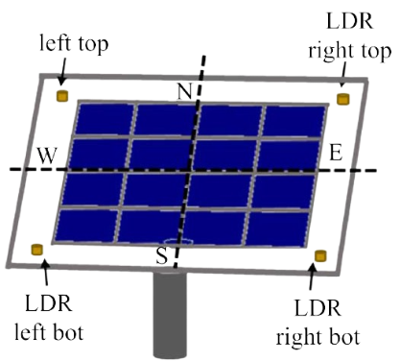
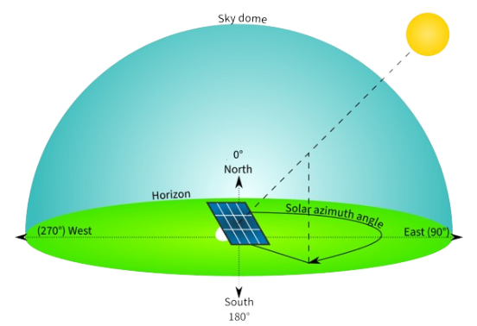
Dual Axis Solar Tracker
Dual-axis solar panels are innovative photovoltaic systems designed to maximize energy production by tracking the sun's movement along two axes, allowing them to optimize sunlight capture throughout the day.
Azimuth-altitude solar panels use a mechanical framework to adjust their orientation along two axes: azimuth (horizontal) and altitude (vertical).
LDR-based solar panels use Light Dependent Resistors (LDRs), also called photocells, to detect light intensity and direction for sun tracking.

Slide 8
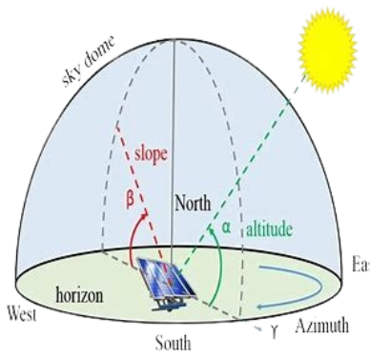
Azimuth Tracking: The system employs a mechanism that allows the panels to rotate horizontally, following the sun's path from sunrise to sunset. This rotation aligns the panels to face the sun as it moves across the sky.
Altitude Tracking: Vertical tilting adjusts the angle of the panels according to the sun's position above the horizon, optimizing the panels to receive sunlight more directly.
Azimuth-Altitude

Slide 9
Fixed vs Single axis vs Dual axis
 | Fixed | Single Axis | Dual Axis
Tracking | Stationary | Typically East-West | East-West and North-South
Efficiency | 15-18% | 18-22% | 20-25%
Cost | Least | Moderate | Highly Expensive
Space Requirement | Most space | Less space | Most space efficient
Maintenance | Minimum | Moderate | Most complex
Applications | Suitable for applications where cost is a significant factor and space is not limited. | Commonly used in larger solar installations, especially where moderate optimization of energy output is required. | Ideal for maximizing energy output in areas with high energy demand or where space is limited.
Advantages | Simplicity Low Maintenance Stability | Improve efficiency Moderate cost Increased energy | Highest efficiency Adaptability High energy generation
Disadvantages | Lower efficiency Low energy Space Requirement | Complexity Limited tracking Space requirement | High cost Maintenance

Slide 10
Fixed solar panels offer affordability but have limited efficiency as they cannot track the sun's movement.
Single-axis solar trackers improve efficiency at a higher cost, while dual-axis solar trackers provide the highest efficiency but come with increased complexity and expense in installation and maintenance.
The choice among these options depends on balancing efficiency, cost, and specific project requirements.
CONCLUSION

Slide 11
THANK YOU

